Slide 1


FULL STACK WEB DEVELOPMENT WITH DJANGO
Lecture 11

Slide 2

Today’s Agenda
Developing Our Django App
Using include Tag
Example

Slide 3
The include Tag
The include tag
The include tag allows us to include the contents of a template inside another template.
Syntax:
{% include template_name %}
The template_name could be a string or a variable.

Slide 4
The include Tag
To understand working of include tag , let’s try an example:
Create a folder called mysixthvsdjangoproject in djangoexamples
Launch VS Code and open the project folder mysixthvsdjangoproject
In VS Code, open the Command Palette (View > Command Palette or (Ctrl+Shift+P)).
Then select the Python: Select Interpreter command:
The command presents a list of available interpreters that VS Code can locate automatically.
Select the virtual environment in our project folder called vsdjango
Run Terminal: New Terminal (Ctrl+Shift+`) from the Command Palette, which creates a terminal and automatically activates the virtual environment by running its activation script.

Slide 5
The include Tag
Now create the Django project, by typing the following command at VS Code terminal in the mysixthvsdjangoproject directory:
django-admin startproject templateproject4
As usual , create an app inside our outer templateproject4 folder by the name templateapp4 using the following command :
django-admin startapp templateapp4

Slide 6
The include Tag
Now go to the outer folder templateproject4 and create a folder there called templates
Now inside templates folder , create a folder called templateapp4
When we execute the above command Django will create appropriate file/folder structure for our app as shown in the next slide

Slide 7
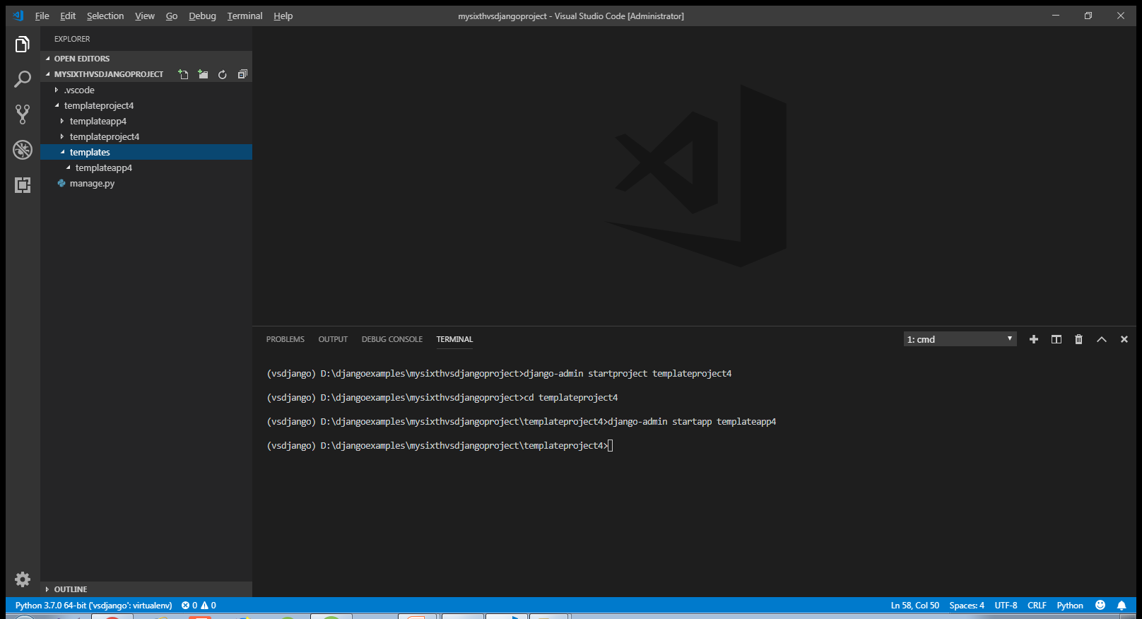
The include Tag

Slide 8
The include Tag
As done before , after creating the app we must let Django know about it by making the entry in the INSTALLED_APPS list of the settings.py file of the default app given by Django.
Open the settings.py file in the inner templateproject4 app of our outer templateproject4 folder and make the entry shown in green color in the INSTALLED_APPS list
Code:
INSTALLED_APPS = [
'django.contrib.admin',
'django.contrib.auth',
'django.contrib.contenttypes',
'django.contrib.sessions',
'django.contrib.messages',
'django.contrib.staticfiles',
‘templateapp4‘,]

Slide 9
The include Tag
Since we are using project level templates folder , then we must inform Django about it.
To do this we must follow the following steps:
Open the settings.py file in the templateproject4 app
Locate the TEMPLATES list and modify it’s DIR key as shown below:
TEMPLATES = [
{ ...
'DIRS': [os.path.join(BASE_DIR, 'templates')],
... },
]

Slide 10
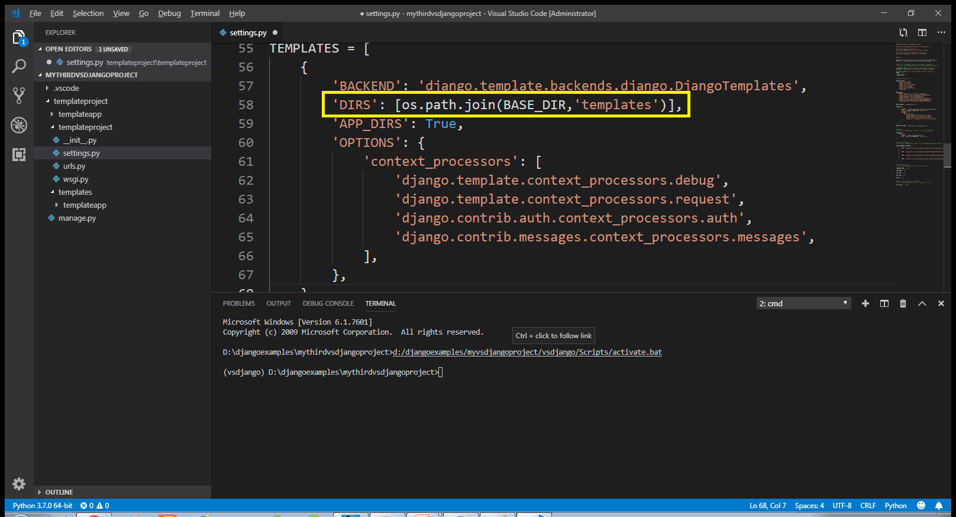
The include Tag

Slide 11
The include Tag
After all the previous activities are over , now create an HTML file called nav.html for the templateapp4 app in the directory templateproject4/templates/templateapp4 and add the following code to it:
templateproject4/templates/templateapp4/nav.html
<nav>
<a href="#">Home</a>
<a href="#">Courses</a>
<a href="#">Contact</a>
<a href="#">Career</a>
</nav>

Slide 12
The include Tag
Now create another page called showdatetime.html in the templates/templateapp4 folder which displays date and time received from the views.py file
This page should first check whether date and time has been sent or not . Assume that the variable containing date and time info will be called now.
If it is sent , then it should display it otherwise it displays the message date time not found!
Try writing the code for it and check it with the code in next slide.

Slide 13
The include Tag
<!DOCTYPE html>
<html lang="en">
<head>
<meta charset="UTF-8">
<title>Include Tag Demo</title>
</head>
<body>
{% if now %}
<p>Current date and time is {{ now }}</p>
{% else %}
<p>Date And Time Not Found!!</p>
{% endif %}
</body>
</html>

Slide 14
The include Tag
Now suppose we also want to include contents of nav.html in the showdatetime.html page so that it also displays a navigation bar.
To do this we will have to use include tag in the showdatetime.html file as shown below:
<body>
{% include 'templateapp4/nav.html' %}
{% if now %}
<h2>Current date and time is {{ now }}</h2>
{% else %}
<h2>Date And Time Not Found!!</h2>
{% endif %}
</body>

Slide 15
The include Tag
Now we have the template in place, we need to update our views.py.
In our views.py file , we must create a datetime object call the render() function passing it 3 arguments:
Request object
Template file path
String representing current datetime
Make sure that we pass the third argument as a dictionary with the key as now and it’s value as current date and time

Slide 16
Solution
from django.shortcuts import render
from datetime import *
def homePageView(request):
curr_date_time=datetime.now()
return render(request,"templateapp4/showdatetime.html",
{'now':curr_date_time})

Slide 17
Solution
After creating and updating the views.py we need to tell Django this is the view we want displayed when someone navigates to the site root (home page).
As usual we do this by configuring our URLs at 2 places:
Inside the templateapp4 directory’s urls.py file
Inside the site’s main urls.py

Slide 18
Solution
In the VS Code create a new file called urls.py in the templateapp4 folder and write the following code in it.
Code (templateapp4/urls.py):
from django.urls import path
from . import views
urlpatterns = [
path('', views.homePageView, name ='index'),
]

Slide 19
Solution
As we know whenever a request arrives it first hits the main urls.py file , that is , the file urls.py in the directory templateproject4.
So we must configure this file also so that it simply redirects the request to our templateapp4’s urls.py file whenever a request arrives

Slide 20
Solution
In the VS Code open the file called urls.py in the templateproject4 folder and update the code in it as shown below in green.
Code (templateproject/urls.py):
from django.contrib import admin
from django.urls import path,include
urlpatterns = [
path('admin/', admin.site.urls),
path('',include('templateapp4.urls')),
]

Slide 21
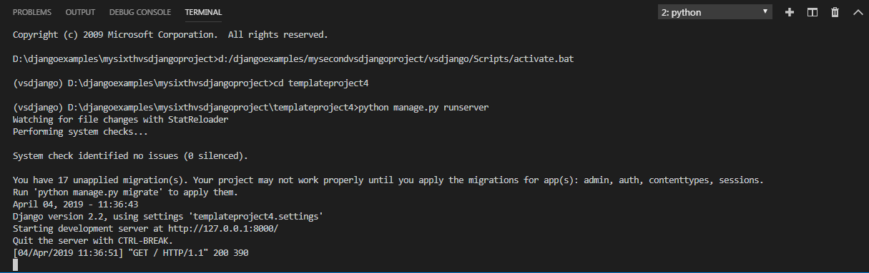
Solution
To run our new templateapp4 , go to the folder templateproject4 by using cd command and type the runserver command in VS Code terminal
cd templateproject4
python manage.py runserver.
The server runs on the default port 8000, and we’ll see output like the following output in the terminal window:

Slide 22
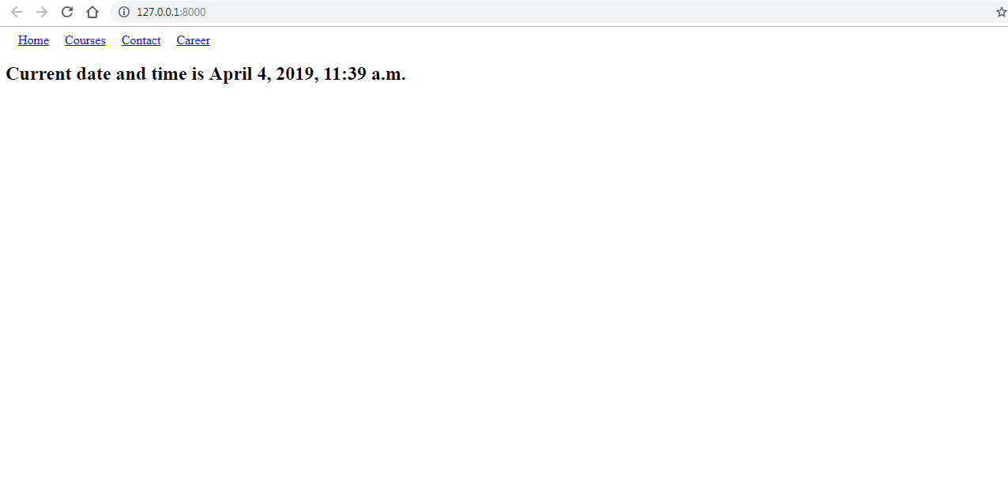
Solution
Ctrl+click the http://127.0.0.1:8000/ URL in the terminal output window to open default browser to that address. Now we should see the the nav bar as well as current date and time on the template based home page

